Slide 1
Waiting for your attendance. We’re starting in 10mins Pleas make sure you installed Anaconda & Python on your devices

Slide 2
AI Programming with Python Nanodegree Program
Mahmoud Khattab.
Data scientist & AI sessions lead.

Slide 3


Happy New Year guys!

Slide 4
Project Session. End-to-end, standard, and real-life project in data science.

Slide 5

Our todays content:
Introduction to Data science lifecycle.
Overview about the project.
Understand the requirements.
Prepare the environment.
Start implementation.
Uploading the code to Github repo.

Slide 6
Data Science lifecycle.

Slide 7
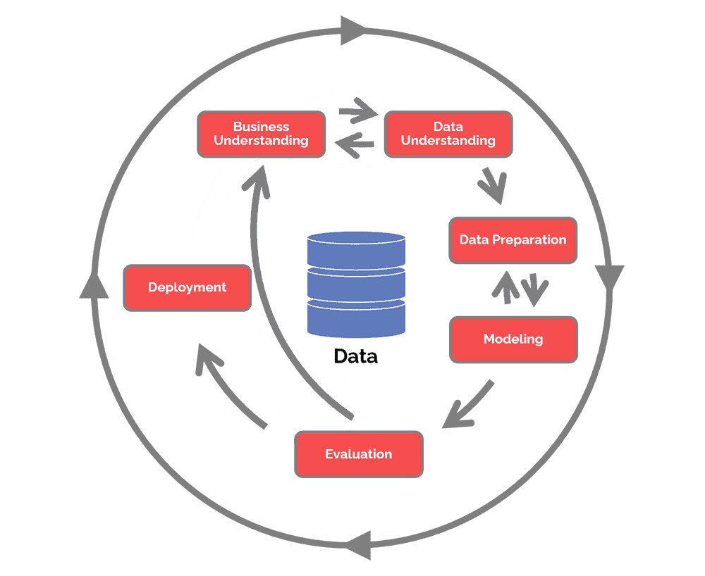
CRISP_DM Data Science Methodology
Business Understanding.
Data Understanding.
Data Preparation.
Modelling.
Evaluation.
Deployment.

Slide 8
Our Project.

Slide 9

Airbnb Predicting the destination of travellers.
https://www.kaggle.com/competitions/airbnb-recruiting-new-user-bookings

Slide 10
Business Understanding

Slide 11
Business understanding
New users on Airbnb can book a place to stay in 34,000+ cities across 190+ countries. By accurately predicting where a new user will book their first travel experience, Airbnb can share more personalized content with their community, decrease the average time to first booking, and better forecast demand.
In this recruiting competition, Airbnb challenges you to predict in which country a new user will make his or her first booking. Kagglers who impress with their answer (and an explanation of how they got there) will be considered for an interview for the opportunity to join Airbnb's

Slide 12
Data Understanding

Slide 13
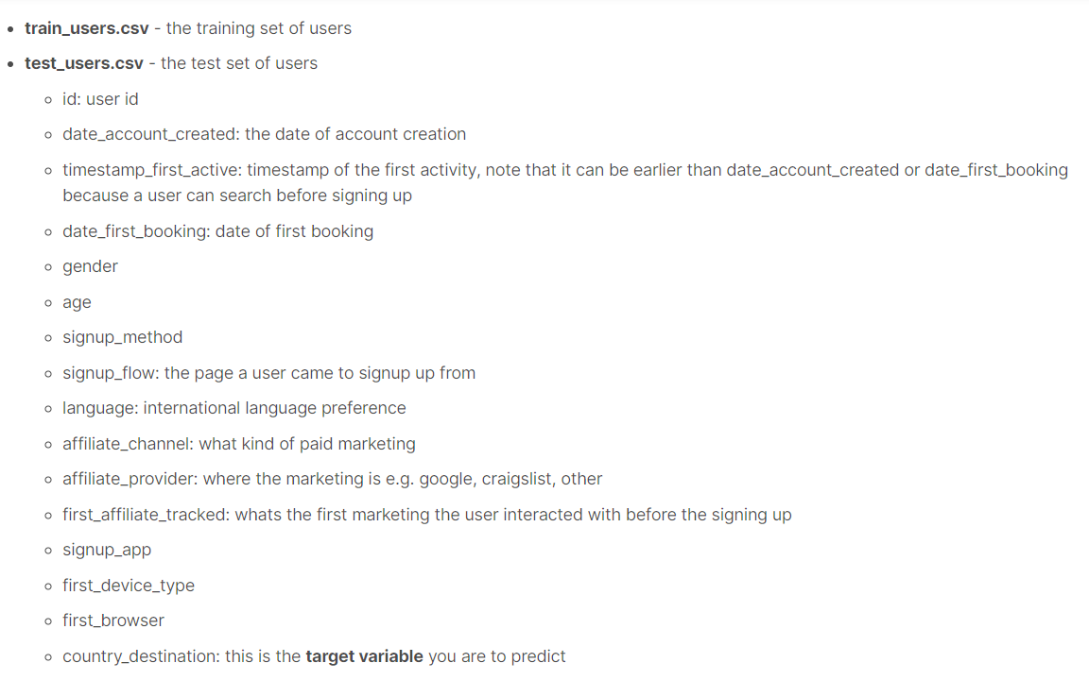
Data understanding

Slide 14
Our Goal.

Slide 15

Our goal:
Predict next destination for the travellers using AI models.
That will highly impact the process of the recommending destinations to the travellers which makes more profit to Airbnb.
Our KPI is the accuracy of the model on the test dataset.

Slide 16
Start Implementing together.

Slide 17
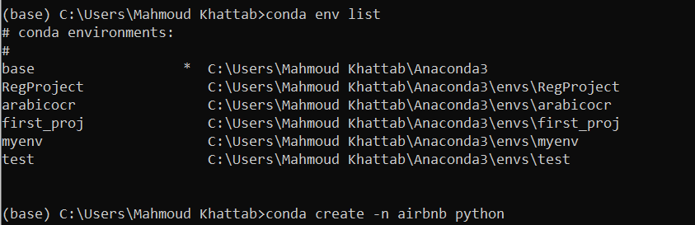
Create virtual environment.

Slide 18
The main steps:
Setup environment.
Setup cookiecutter and create one.
Create github repo.
Create Notebooks.
Install libraries.
Analyze the data and gain insights.
Upload that to the repo.

Slide 19
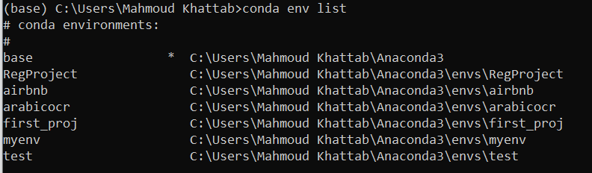
2. Check the envs and activate the airbnb env

Slide 20
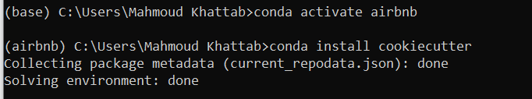
3. Activate the airbnb env.

Slide 21
4. Install the CookieCutter

Slide 22
What is Cookie Cutter?
Why we need it?

Slide 23
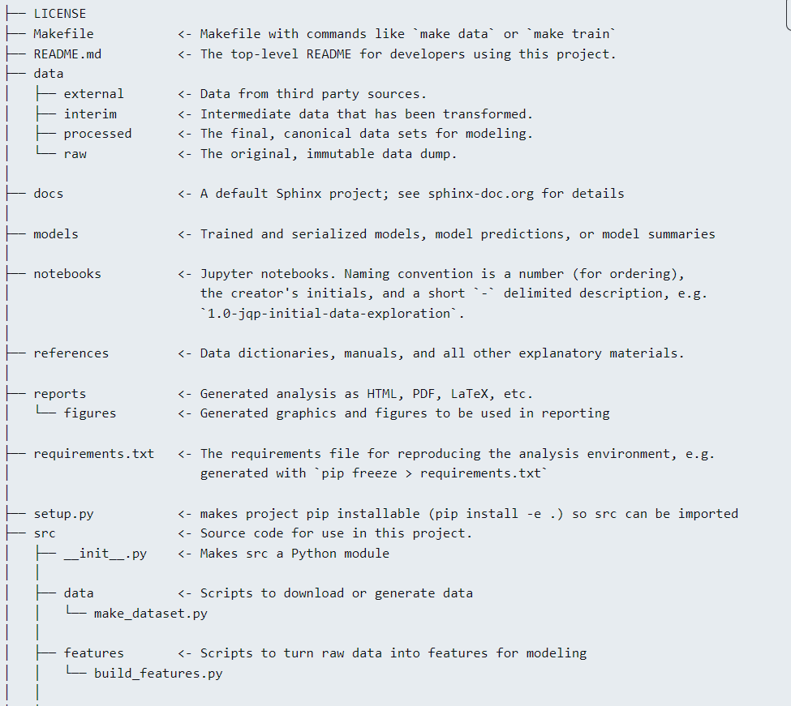
A logical, reasonably standardized, but flexible project structure for doing and sharing data science work.
This folder structure allows everyone looking at your code to understand it right away. It also provides many different functions (as part of a Makefile) that simplify the workflow of your project.
https://drivendata.github.io/cookiecutter-data-science/

Slide 24
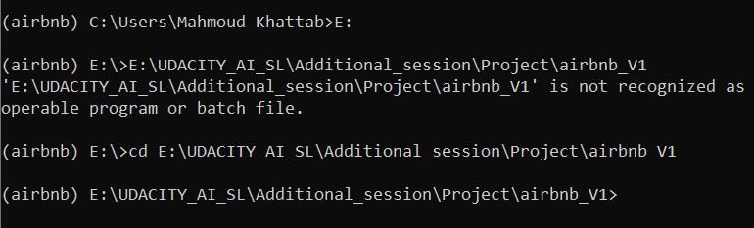
5. Navigate to the directory & Create the structure.

Slide 25
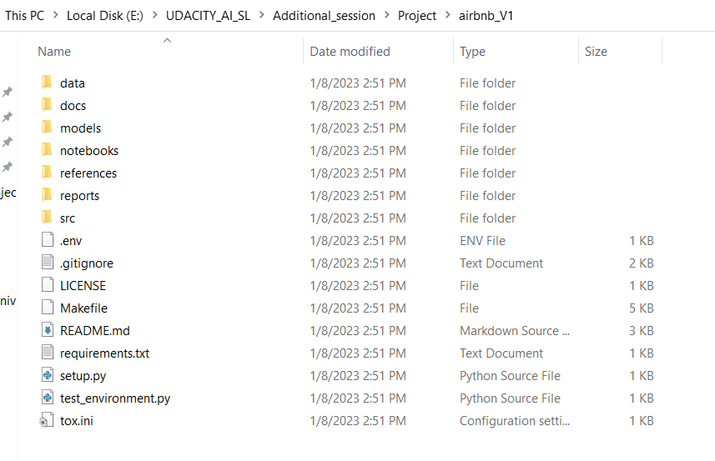
This is the structure

Slide 26
Install important libraries

Slide 27
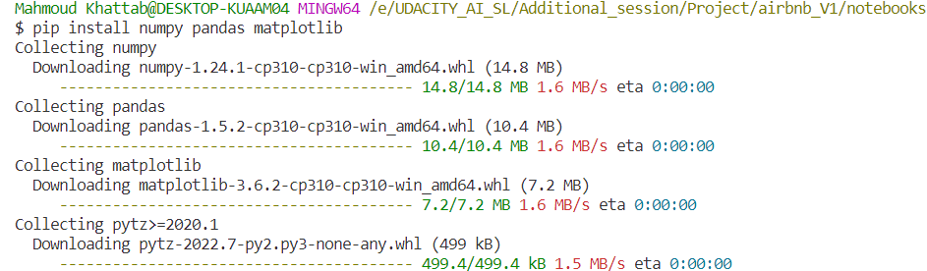
6. Install required libraries.

Slide 28
10 mins Break!

Slide 29

Welcome Back!

Slide 30
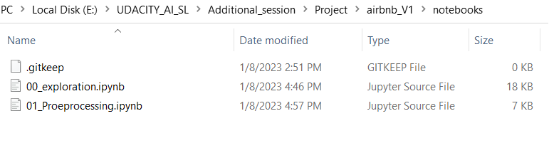
7. Create the notebooks with meaningful names

Slide 31
Create GitHub Repo.

Slide 32
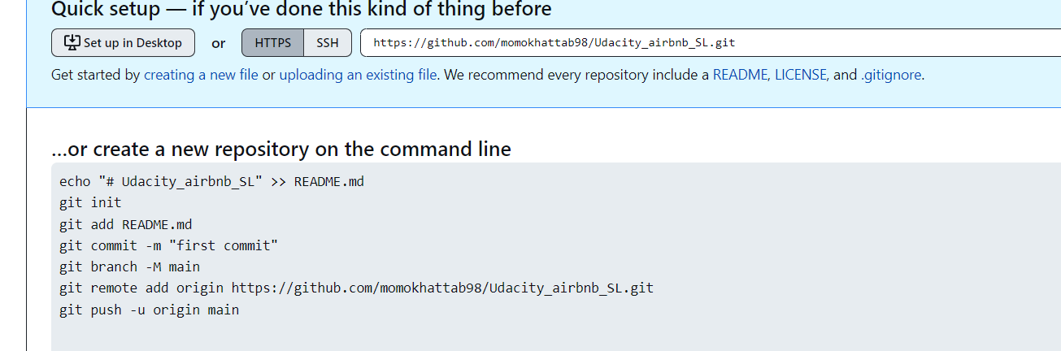
Create Repo

Slide 33
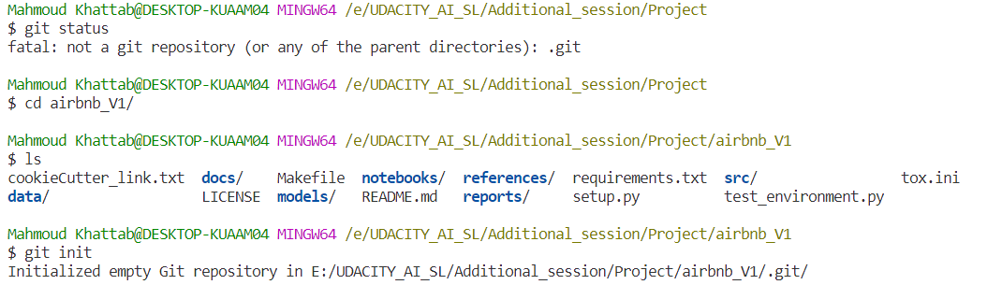
Git commands: (git status, git init)

Slide 34
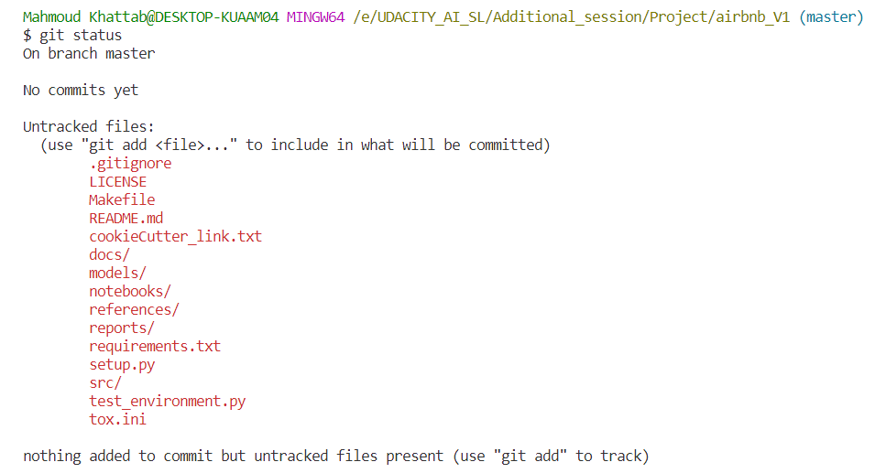

Slide 35
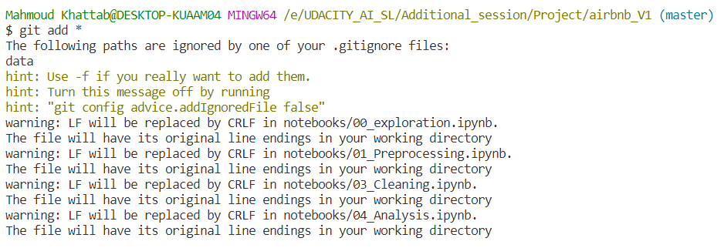

Slide 36
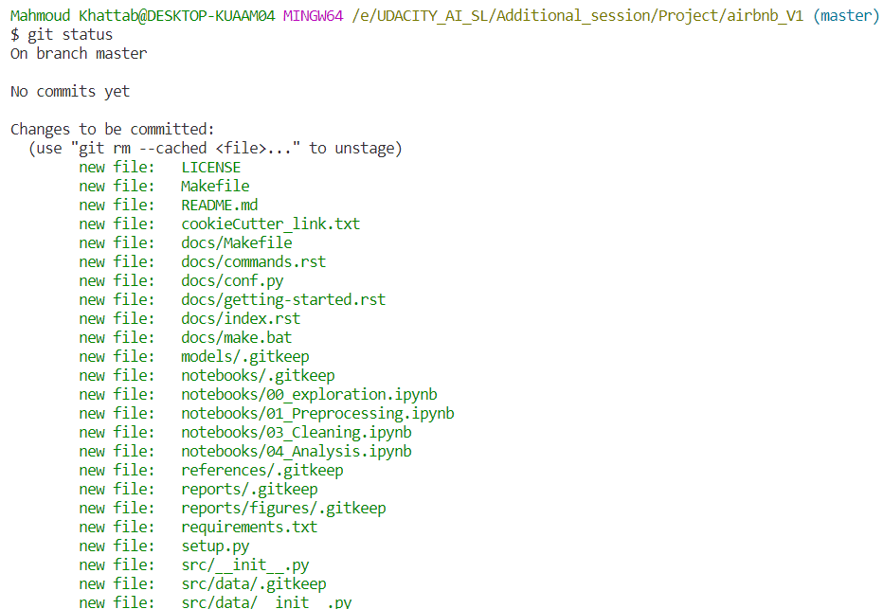

Slide 37
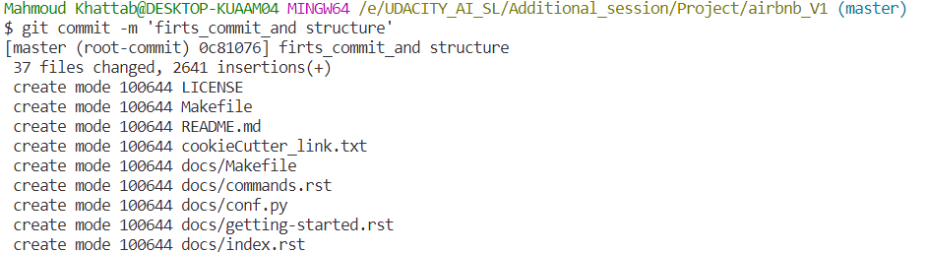

Slide 38
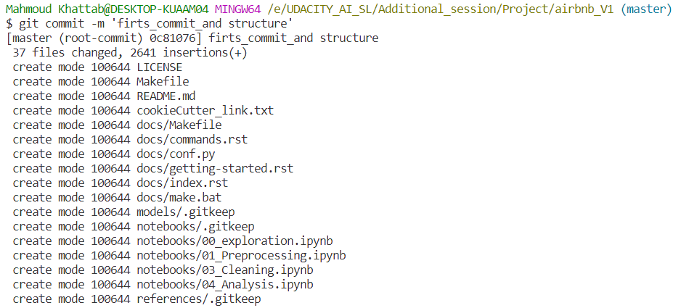

Slide 39
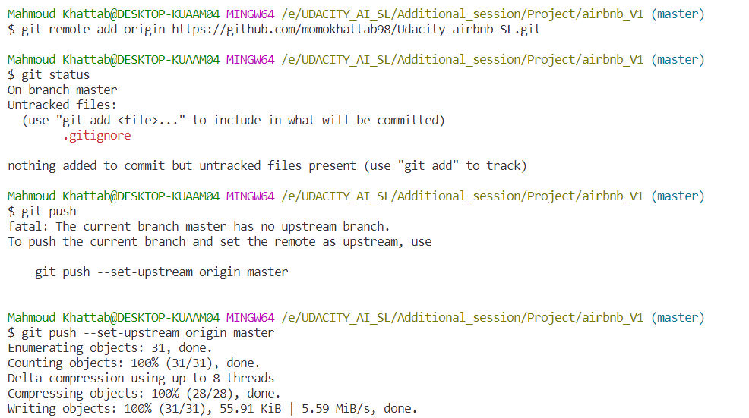

Slide 40
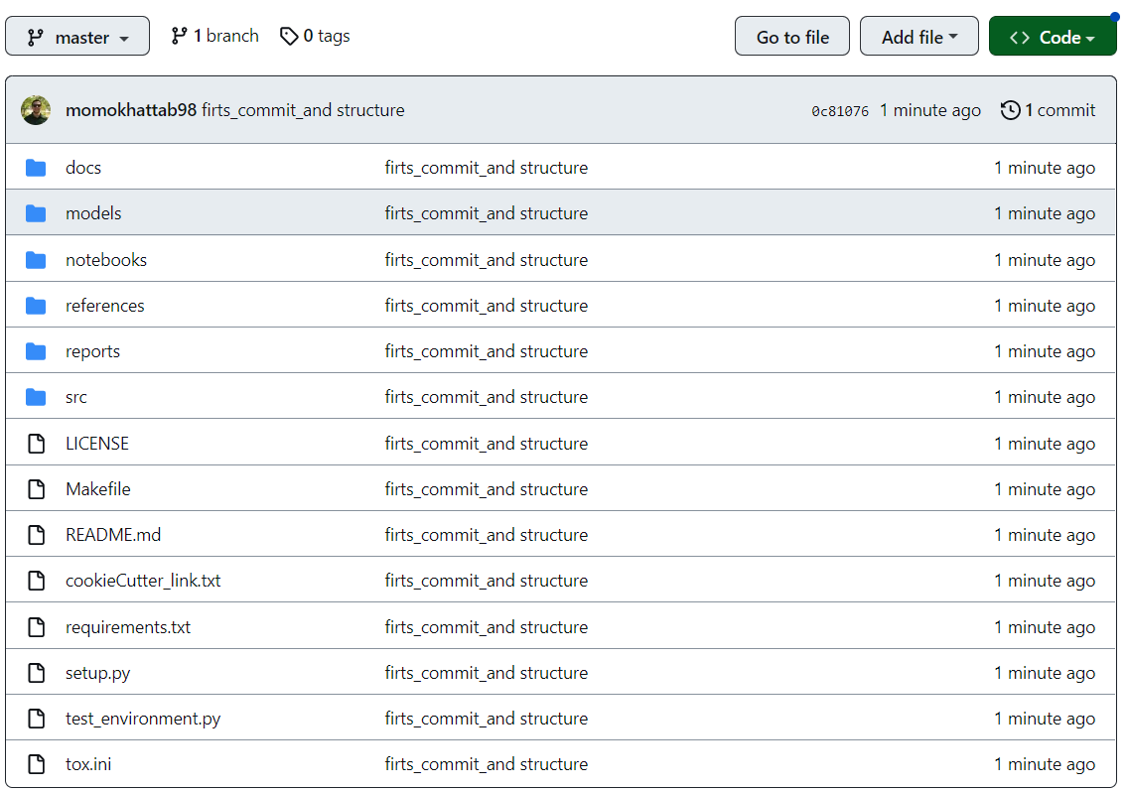
The Repo created

Slide 41
Notebooks

Slide 42

Notebooks
Exploration.
Preprocessing.
Cleaning.
Analysis.
Features Engineering.
Modeling.
Scripting.
Deployment.

Slide 43
Exploration Notebook.
Explore data.
See samples of data.
Make sure about the same files and Columns.

Slide 44
2. Pre-processing Notebook.
Choose the right data types of your columns.
Change data types from one to another which helps you in all the project.
Dropping wrong and unrelated data.
At the end export data into the Pickle processed dataset file.

Slide 45
3. Cleaning Notebook.
Check the missing values Nans and handle them.
Check the duplicates and handle them.
Check the Unknowns and handle them.
At the end export data into the Pickle processed dataset file.

Slide 46
4. Analysis Notebook..
Ask good questions and try to answer them.
Visualize the un-ivariate, BI-Variate, and multi-Variate.
Show all important Descriptive statistics.

Slide 47
5. Features Engineering Notebook..
Choose the important features to train the models on.
Create more than one features set to train the model like to train it on all the dataset and/or choose some specific set of features to train on.
Create and extract new features based on the current ones.

Slide 48
6. Modelling Notebook..
Create more than one model to test it on the more than one features set.
Use the Cross-Validation concept in the train/test split ; To make tuning for the Hyperparameters and get higher scores.
Test and Evaluate your models.
Use the help of AutoML libraries.
Save your model as a checkpoint.

Slide 49
Open Area for Questions and suggestions.

Slide 50




Before finishing feel free to reach me If you have any question,
ideas,
suggestions
or even a thought.
Slack: Mahmoud Khattab_Udacity_SL
Slack Channel : sl-mahmoud
Email: mahmoud.khattab128@gmail.com
LinkedIn: MahmoudKhattab-Lnkdn

Slide 51
Thank You

